Slide 1


ELITE MINDS
PROTOTYPE PRESENTATION

Slide 2
PROBLEM STATEMENT
The problem is that there is lack of proper management of resource used.
Poor yields.
Record keeping of Recourses.
Employee management.
Low Returns.
Tuli Block have problem with productivity management.g carrot management
From farm to packging.

Slide 3
Proposed Solution
The system will be used by stakeholders
E.g. Farmers such as Tuli block
The system has 2 parts the desktop application and website.
The Desktop side will enable the Farmers to records yield and manage assets.

Slide 4
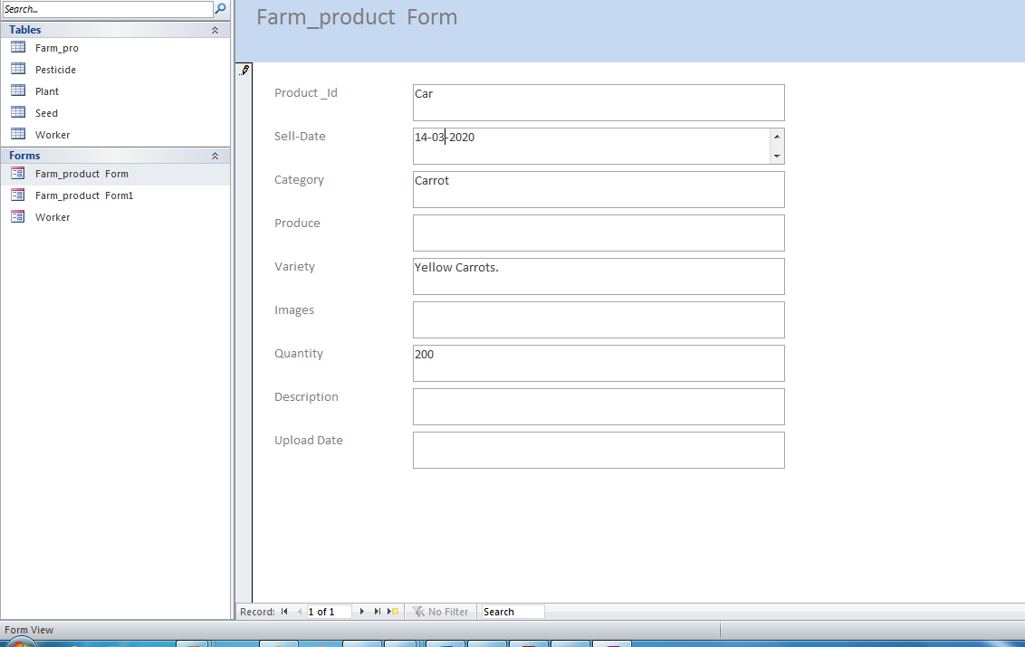
Database

Slide 5
MODULES
CROP MODULE
-crop planted(name, type)
-number of seedlings planted
-number of plants dead
-% yield
-duration
Workers Module
daily/weekly/monthly
Dead seedlings
Irrigation(0/1/2)
Pesticides
Fertilisers
Cultrivation
Diseases
Other..
Alert module
-due date for –pesticides, irrigation,harvesting

Slide 6
MODULES CONTINUATION…
STATISTICAL MODULE
-for the owner
-cost of a product
-cost of machinery
-selling price
-harvest(amount)
-disposed crops
REPORTS MODULE
-% yield
-% harvested
-% sold
-% lost
-profit/loss
MARKETING MODULE
-place

